Slide 1
Cyber Security Foundational
SIF Foundational Project Part 1: Scoping the Industry and Impact

Slide 2
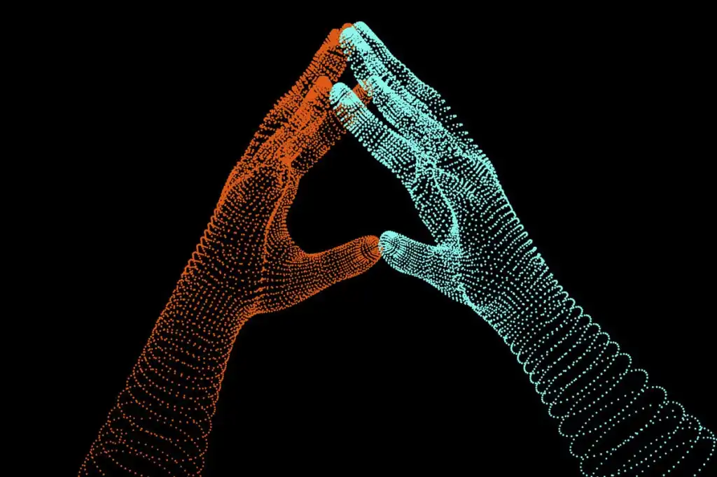
Group Members of Project
Group Leader Name (& share one line of your interest in cyber security!)
Michelle Ceacelia - (To ensure an updated knowledge of safety in an ever evolving digital world.)
Member 1 Name (& share one line of your interest in cyber security!)
Sutjipto Budiman (updated the latest knowledge of cyber security)
Member 2 Name (& share one line of your interest in cyber security!)
Bonaventura Harmaji ( Machine Learning in Cyber Defence and Offence)
Member 3 Name (& share one line of your interest in cyber security!)
Anupam Kumar Gupta (Incident response and forensic analysis.)
Member 4 Name (& share one line of your interest in cyber security!)
(please edit)

Slide 3
Safeguarding Digital Assets in Dental Clinics: Addressing Cybersecurity Challenges in Small Healthcare Centers.
Small healthcare centers, such as dental clinics, are increasingly becoming a target for cyberattacks due to the abundance of valuable patient data they store, including personal information, medical histories, and insurance details. With limited resources and expertise in cybersecurity, these clinics are vulnerable to a range of cyber threats, such as ransomware, malware, and phishing attacks. These attacks can result in significant financial and reputational damage to the clinic, as well as breaches of patient privacy. Therefore, there is a pressing need for dental clinics to prioritize cybersecurity and implement effective measures to safeguard their digital assets.
YOUR CASE: As cybersecurity consultants for an dental clinic, your scope would be to develop a comprehensive cybersecurity risk management and cyber hygiene plan that would protect the dental clinic digital assets, data, and systems from cyber threats.
We look to our nearest neighbour (Australia) and their issues with small healthcare cybersecurity to learn and enforce such cyber hygiene plan and understanding to developing countries such as Indonesia.

Slide 4
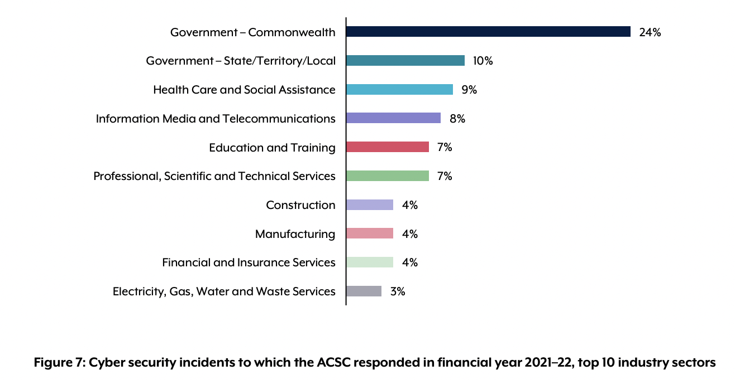
Safeguarding Digital Assets in Dental Clinics - Contextualization of Issue in Australia
Dental practices can be an easy target for cybercriminals as they hold valuable patient data but lack the in-house cybersecurity resources and sophisticated anti-fraud procedures of larger enterprises. Dental practices can be vulnerable to various cyber threats, including ransomware, phishing, malware, and business email compromise. To protect against these threats, practices can use virtual private networks to encrypt data, keep anti-virus software up to date, install antivirus software, urge staff not to click on dodgy links or download suspect documents, and educate employees to be suspicious of dubious correspondence (BiteMagazine, 2021).
Healthcare sector is in the top 3 top of cyberattacks in Australia for the 2021–22 financial year(ACSC, 2022, p. 27).

Slide 5
Safeguarding Digital Assets in Dental Clinics - Contextualization of Issue in Australia
“The severity of cyber security incidents is increasing. Nearly 15 per cent of incidents in the 2021–22 financial year were categorised as C3, up from approximately 6 per cent in the previous financial year” (ACSC, 2022, p. 26).
Dental One, a dental clinic in Australia, has suffered a data breach where 500 GB of customer health data has been compromised by a threat actor who has posted the stolen data on the dark web. To avoid such incidents, businesses should prioritize cybersecurity by regularly updating software, using strong passwords, and training employees on how to detect and respond to potential threats. In the event of a data breach, businesses should take immediate action to contain the breach, notify affected customers, and implement additional security measures to prevent future breaches. Customers should also be advised to monitor their credit reports and bank accounts for any suspicious activity (Cybersecurity News, Firewall Daily Editorial, December 2022).

Slide 6


Sustainable Development Goals
Improved patient care: Digitization of patients records and health information, dental clinics can improve quality and efficiency of patient care. This includes faster access to patient information, easier tracking of patient progress and improved communication among healthcare providers (https://sdgs.un.org/goals).
Improved productivity: Digitization of patient records and other administrative tasks, dental clinics can increase productivity and efficiency. This allows dental professionals to focus more on patient care and other high-value activities.
Enhanced skills and training: Digitizing a dental clinic data system requires dental professionals to learn new technical skills, such as using digital software and tools. This enhances their technical and vocational skills, making them more competitive in the job market and better prepared for future roles.
Increased economic growth: By improving productivity and efficiency, digitizing a dental clinic data system can contribute to increased economic growth. Creating more job opportunities, including decent jobs and entrepreneurship, which can further contribute to economic growth (https://sdgs.un.org/goals).

Slide 7
Understanding the IT Tools
What are 5 technology infrastructure / tools that are used in the dental clinic? (Think creatively of some!)
Practice management software
Electronic Health Record (EHRs)
Financial Payment Connection (e-wallet, transfer,cash)
Wi-Fi Network
Local Storage Devices
Security Software and Firewalls

Slide 8
Understanding the Stakeholders
What are the assets and data that need to be protected, and what are the potential threats and vulnerabilities facing the clinic and patients?
Data loss or damage: If the local storage device fails or becomes damaged, the clinic may lose important patient information and data. This can lead to disruptions in patient care, and may result in legal or financial consequences.
Physical theft or damage: The local storage device may be physically stolen or damaged, which can also result in data loss or exposure. This can compromise patient privacy and confidentiality, and may also result in legal or financial consequences.
Cybersecurity threats: The local storage device may be vulnerable to cyber threats such as malware, ransomware, or phishing attacks. If these threats are successful, they can lead to data loss, data theft, or other types of damage.
Lack of accessibility: If the local storage device is not accessible from remote locations, this can limit the ability of dental professionals to access patient information and provide timely care. This can impact patient outcomes and satisfaction.
Limited scalability: If the local storage device does not have sufficient capacity, this can limit the ability of the clinic to expand their patient care services. This can limit growth opportunities and may result in reduced revenue.

Slide 9
Understanding the Stakeholders
Who are the stakeholders in the clinic, and what are their roles in cybersecurity risk management?
Each stakeholder has a role in cybersecurity risk management to ensure that the clinic's IT systems are secure and patient information is protected. Dr. Maria Cilvia, as the CTO and owner, is responsible for overseeing the overall management of the clinic, including information technology. She plays a critical role in ensuring that cybersecurity policies and procedures are implemented and followed to mitigate the risk of cyberattacks.
Dr. Fransisca Amy, as a dentist, oversees overall billing/full financial control within the clinic. This role involves ensuring that patient information is protected from cyber threats.
The dental assistants, Amilia Lin and Sarah Lee, are responsible for updating the clinic's stock based on usage. They play a role in ensuring that the clinic's inventory management systems are secure and updated, to protect against cyber threats.
The receptionist, Emily Davis, is responsible for accepting patients and registering new and existing patients, including payment processing. This role involves collecting and storing sensitive patient information, which must be protected from cyber threats.
Michael Nguyen, as the CTSO, is responsible for managing the clinic's IT infrastructure and ensuring that there are daily backups to local storage. He plays a critical role in implementing cybersecurity policies and procedures, including access controls, data encryption, and malware protection.

Slide 10
Understanding the Stakeholders
User Access declaration in system
S. No | Personnel name | Level in security pyramid | Edit Price of Stock | Edit Stock Quantity | Change Passwords | Edit Price of Doctor Services | Edit of Registration & Schedule
1 | Dr. Maria Cilvia (Owner) | Executive/Sec Mgmt | TRUE | TRUE | TRUE | TRUE | TRUE
2 | Dr. Fransiska Amy (Partner) | Technical | FALSE | FALSE | FALSE | TRUE | FALSE
3 | Amilia Lin, Dentist Asst | Technical | FALSE | TRUE | FALSE | FALSE | FALSE
4 | Sarah Lee, Dentist Asst | Technical | FALSE | TRUE | FALSE | FALSE | FALSE
5 | Emily Davis, Receptionist | Technical | FALSE | FALSE | FALSE | FALSE | TRUE
6 | Michael Nguyen IT Admin | Technical | FALSE | FALSE | TRUE | FALSE | TRUE

Slide 11
Understanding the Stakeholders
Who are the stakeholders in the clinic, and what are their roles in cybersecurity risk management?
S/N | Device | Owner | Registration ID | IPv4 | Public/Private | Password | Anti-Virus
1 | IMac 2022 (M1) | Dr Maria Cilvia (treatment room 1) Access to dental assistant Amilia Lin | REG-DOC-MC001 REG-DA-AL003 | 192.168.1.10 | Private | SmileCilvi1*** AmiSmile0815! | McAfee
2 | IMac 2022 (M1) | Dr Fransisca Amy (treatment room 2) Access to dental assistant Sarah Lee | REG-DOC-FA002 REG-DA-SL004 | 192.168.1.11 | Private | FransSmle12$ SmilLeee24>>* | McAfee
3 | Canon Printer | Control Item | REG-PRINTER-09 | 192.168.1.30 | Private | Nil | Nil
4 | ASUS Laptop | Receptionist - Emily Davis (Accessible to IT and Doctors) | REG-REC-ED005 | 192.168.1.40 | Private | RcptSmle01#$ | Window Defender
5 | 2TB Seagate Hard Drive (Owner) | Dr Maria. C | HDD-MC1001 | NIL |  | MarCil1224^*$ | Nil
6 | 2TB Seagate Hard Drive (Partner) | Dr Fransisca. A | HDD-FA1001 | NIL |  | MyFraiCa10!* | Nil

Slide 12
Understanding the Stakeholders
Who are the stakeholders in the clinic, and what are their roles in cybersecurity risk management?
S/N | Device | Owner | Registration ID | IPv4 | Public/Private | Password | Anti-Virus
7 | “SmileStorage” Server (I9 quad-core processor, Nvidia with 2TB CPU storage and 8G RAM) | Control Item | REG-IT-MN006 | 192.168.1.50 | Private | StorSmle0610* | Nil
8 | WAPs (Wireless Access Points) Wi-Fi | Wireless Internet access for personal devices and patients (Control Item) | REG-WAP-12 | 192.168.1.60 | Private | D3ntst@Open# | Firewall Standard
9 | Smart TV (3 - Lounge, Room 1 and 2) | Entertainment | REG-TV1-13 REG-TV2-14 REG-TV3-15 | 192.168.1.70 192.168.1.71 192.168.1.72 | Private | Nil | Nil
10 | Internet Router | Internet Access | indihome | Dynamic | Private | D3ntstSml99!^ | Firewall std
11 | XRay (teeth imaging) | Control Item | REG-XRAY | 192.168.1.20 | Private | @DentRay123! | Nil
12 | Website | Hosting public ISP Michael Nguyen | Webdentist | 125.163.29.10 | Public | D3nt1@st@dm | Nil
13 | 6 personal devices (mobile phones) | Personal owner, partner and employee use | REG-PHONE1-03 REG-PHONE2-04 REG-PHONE3-05 REG-PHONE4-06 REG-PHONE5-07 REG-PHONE6-08 | 192.168.1.12 192.168.1.13 192.168.1.14 192.168.1.15 192.168.1.16 192.168.1.17 | Private

Slide 13
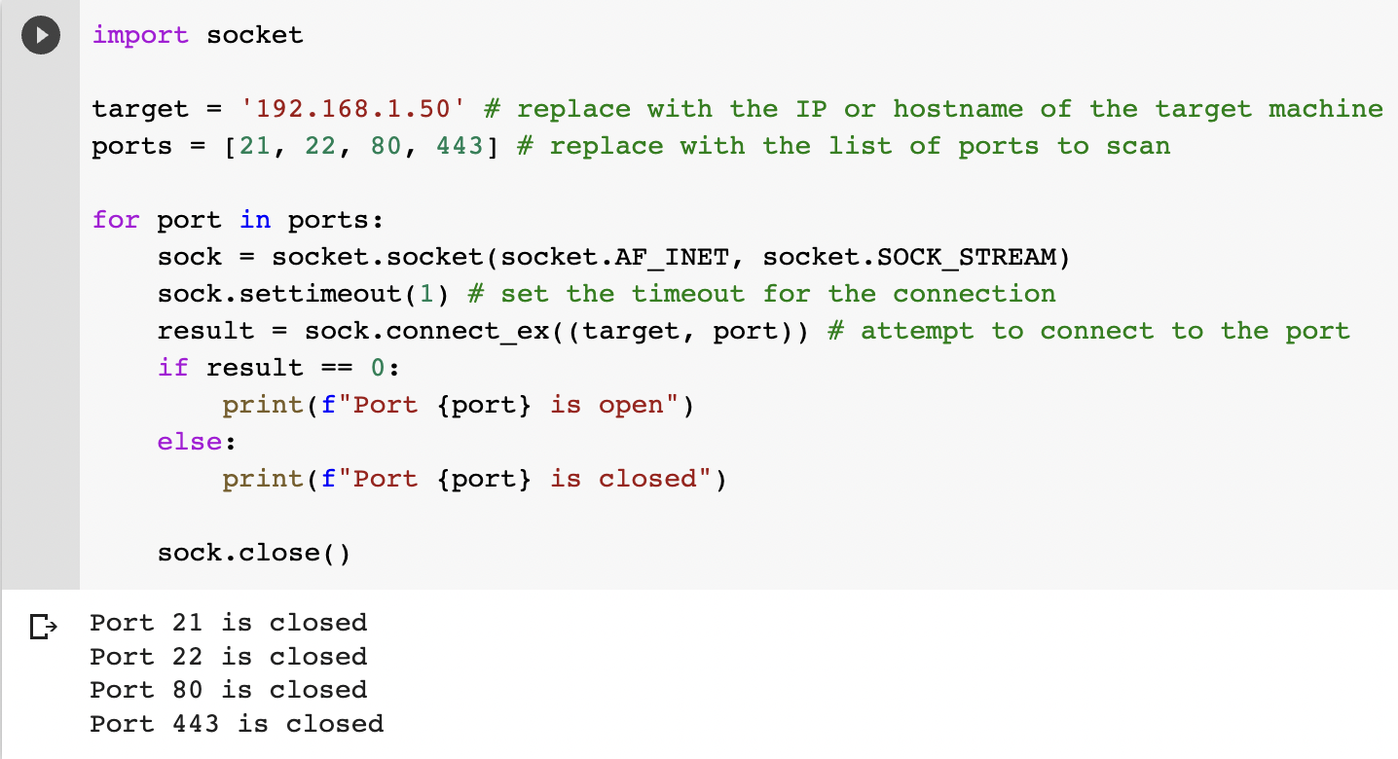
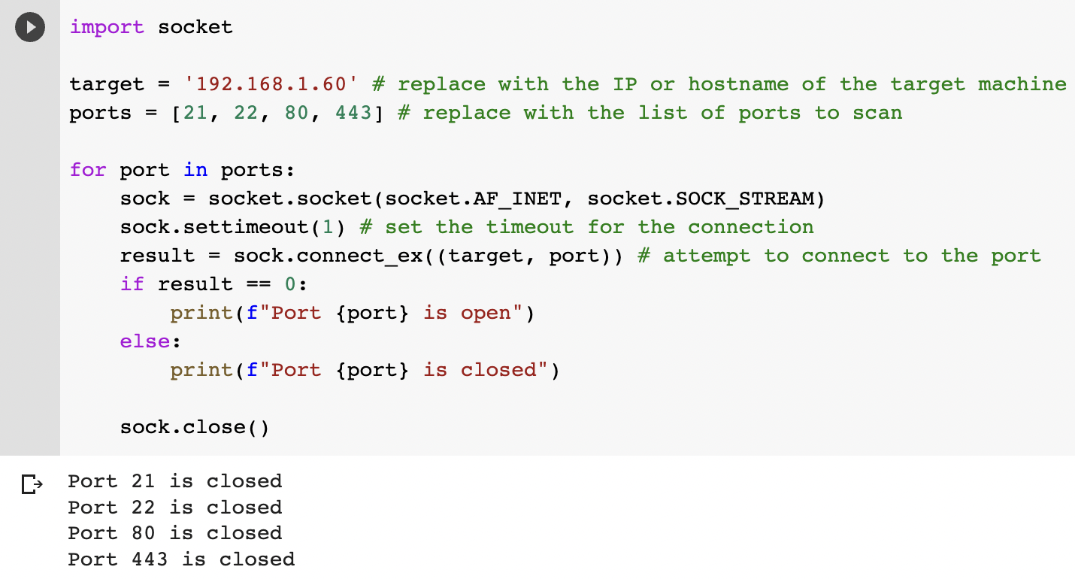
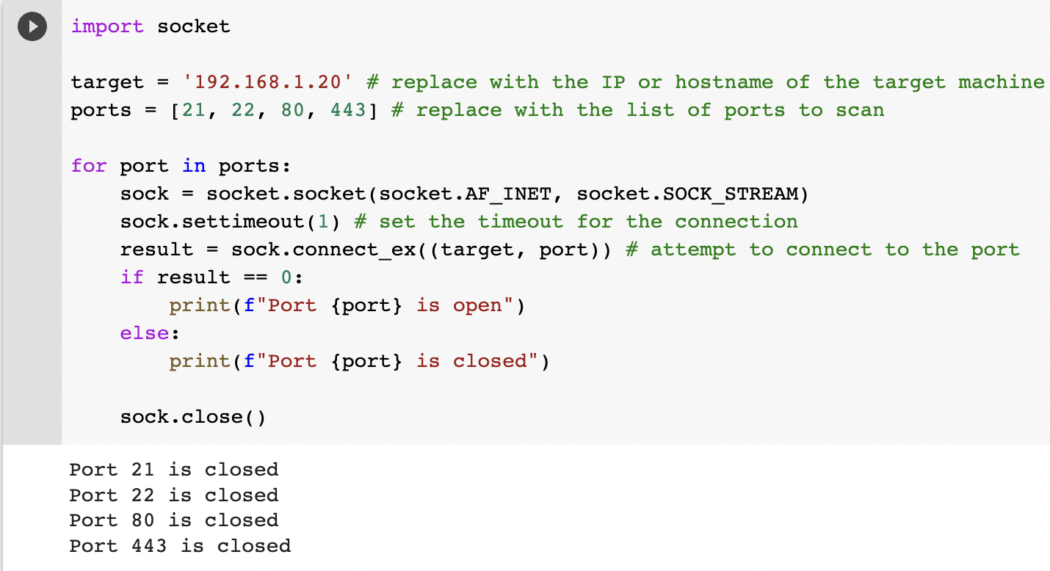

Status of port test
S/N | Control Item | Registration ID | Ports scanned | Status of port | Follow-up action required
1 | X-ray teeth imaging | REG-XRAY | 21,22,80,443 | All closed | Open the ports only when the need to print arises.
2 | WAPS Wifi | REG-WAP-12 | 21,22,80,443 | All closed | Should be open during working hours
3 | SmileStorage” Server (I9 quad-core processor, Nvidia with 2TB CPU storage and 8G RAM) | REG-IT-MN006 | 21,22,80,443 | All closed | Should be open during working hours
4 | Canon printer | REG-PRINTER-09 | 21,22,80,443 | All closed | Should be opened when required

Slide 14
Understanding the Risks
What are the assets and data that need to be protected, and what are the potential threats and vulnerabilities facing the clinic?
Asset 1: Patient Data
Asset 2: Connected Medical Devices
Vulnerability 1: Human error input | Potential threat 1: Incorrect treatment | Risk 1: Reputation
Vulnerability 2: Weak passwords | Potential threat 2: Unauthorised access | Risk 2: Patient data loss or misuse
Vulnerability 3: Inadequate access control | Potential threat 3: Cyber attacks (such as phishing, malware, or ransomware) | Risk 3: Loss of patient trust, legal and financial penalties, reputational damage
Vulnerability 1: Human error input | Potential threat 1: Incorrect treatment | Risk 1: Data damage
Vulnerability 2: Inconsistent electricity grid | Potential threat 2: Loss of treatment time | Risk 2: Broken medical device, loss of profit
Vulnerability 3: Outdated or unsupported operating systems and software that cannot be patched or updated | Potential threat 3: Malware or viruses that infect the device or the network, Physical theft or tampering of the device, Denial of Service (DoS) attacks | Risk 3:Liability risks from using insecure medical devices, Reputational damage to the clinic's reputation

Slide 15
Understanding the Risks
What are the assets and data that need to be protected, and what are the potential threats and vulnerabilities facing the clinic?
Asset 3: Wi fi/ Internet Connectivity/ Computers/ Printers
Asset 4: Website
Vulnerability 1: Weak password | Potential threat 1: Spoofing | Risk 1: Data theft online (hacker)
Vulnerability 2: Local access | Potential threat 2: Plug-in device | Risk 2: Local data theft
Vulnerability 3: Lack of encryption and secure protocols for Wi-Fi networks | Potential threat 3: Data interception or eavesdropping on Wi-Fi network traffic, Malware or viruses introduced to the network through a compromised device | Risk 3: Losing patient trust, Breaches of patient data and confidential information
Vulnerability 1: Weak coding | Potential threat 1: Defame | Risk 1: Reputation, loss of prospect
Vulnerability 2: Weak hosting infrastructure | Potential threat 2: DDOS | Risk 2: Customer cannot access the website, lost of prospect customer
Vulnerability 3: Human error | Potential threat 3: Inaccurate information/schedule | Risk 3: Reputation, loss of customer

Slide 16
Risk Ratings (From 1 - 5)
Risk 1
Risk Probability (1-5)
Risk Likelihood (1-5)
Risk Impact (1-5)
Patient Medical Data
4, Small clinics are do not have a large budget for effective safeguards.
4, Higher risk as this is the most valuable information for the hackers.
5, Highest as it might cause financial, reputational and all health related loss
Risk 2
2,Most devices could not be accessed remotely
2,Medical devices have their own software systems.
3, Could lead to mistreatment and financial loss
Connected Medical Devices
Risk 3
5,This is the most convenient way for the hackers to intrude.
5,The advancement in IT is making us increasingly susceptible to loss of data. Smaller clinics are unable to allocate considerable budget for this.
4, Impact is severe however can be reduced if defensive systems are in place.
Wifi/Internet connectivity and Computers/Printers
Risk 4
3. There are possibility that the hacker wants to attack the website
1. The clinic has hired a reputable ISP provider to provide hosting & Website
1. Loss of potential and existing customer, but the customer can contact through phone
Website defame/ malfunction

Slide 17
Understanding the IT Tools
For each of the technology used, what are some security infrastructure
Identify : The Computers/Printers/Medical devices/Website.
Protect: Install the latest antivirus/firewall/backup in place.
Detect: Auto-update the antivirus/softwares. Keep a record of all the employees who logged in and out of system.
Respond: Report any suspicious activity. Use port scanning and other tools to block any authorised access.
Recover: Use backup drives to recover the data after ensuring that the threat is completely removed from the system.

Slide 18
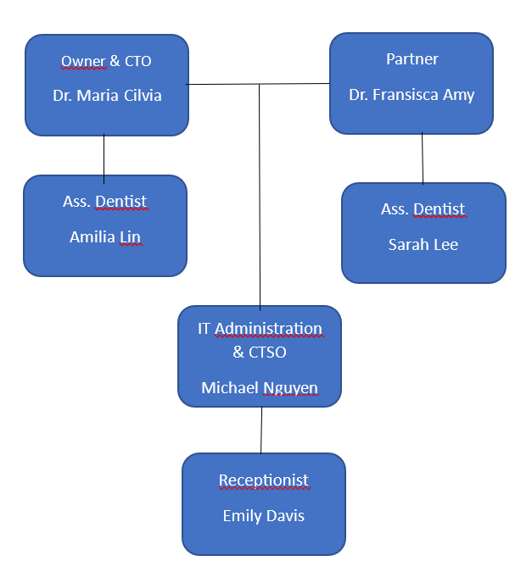
Structure of the Dental Clinic
Notes:
To work in the field of cyber security, knowledge of Operating Systems, Virtualization in Programming and Networking are important.

Slide 19
Structure of the Dental Company
What are some roles and responsibilities of the employees general dental clinic cyber security?
The dentists (owner and partner) - responsible for ensuring that all patient data is securely stored and protected, and for providing guidance and direction to other employees on security protocols.
The dental assistants - responsible for maintaining the security of patient data during appointments, ensuring that patient information is not viewed or accessed by unauthorized individuals, and reporting any security incidents or concerns to the IT administrator.
The receptionist - responsible for monitoring and controlling access to the clinic's physical premises, as well as managing access to patient records and other sensitive information.
The IT administrator - responsible for managing and securing the clinic's network infrastructure, including setting up firewalls, configuring access controls, monitoring network traffic, and identifying and addressing potential security threats. The IT administrator is also responsible for ensuring that all employees are trained in cybersecurity best practices, such as creating strong passwords, avoiding phishing scams, and using secure networks to access patient data.

Slide 20
Dental Company - Cyber Hygiene Plan
What are some roles and responsibilities of the employees general dental clinic cyber security?
Hardware:
Install firewalls to secure the network and block unauthorized access.
Use antivirus software to protect the clinic's computers and network from malware and other cyber threats.
Use secure routers and access points to ensure that only authorized devices can access the network.
Use encryption for all data in transit and at rest to protect it from unauthorized access.
Regularly update all hardware, including computers, servers, routers, and other devices, with the latest security patches and firmware updates.
Training:
Train all employees on the importance of cybersecurity and how to prevent cyber attacks, such as phishing scams, social engineering, and password attacks.
Conduct regular cybersecurity awareness training sessions to ensure that employees are up-to-date with the latest cyber threats and prevention methods.
Develop a cybersecurity policy that outlines the acceptable use of computers, internet, and email for employees.
Passwords:
Require strong passwords of at minimum 12 characters (Upper, lower case, symbols and numbers) for all devices, accounts, and applications that employees use. Also checking with the password checker safety from the csa.gov.sg or other types of official password checkers.
Enforce password policies, such as requiring password changes every 90 days and disallowing the use of weak passwords.
Access control:
Limit employee access to sensitive data and systems to only those who require it to perform their job duties.
Implement access controls to ensure that only authorized users can access sensitive data and systems.
Use multi-factor authentication to provide an extra layer of security.
What are some roles and responsibilities of the employees general dental clinic cyber security?

Slide 21
Dental Company - Cyber Hygiene Plan
What are some roles and responsibilities of the employees general dental clinic cyber security?
Cybersecurity beyond the office:
Implement secure remote access for employees who need to work from home or other remote locations.
Use VPNs (Virtual Private Networks) to encrypt all data that is transmitted between the clinic's network and remote devices.
Data protection:
Regularly backup all data to prevent data loss in case of a cyber attack.
Use encrypted hard drives and other data storage devices to protect sensitive data at rest.
Store backup data off-site or in the cloud to ensure that it is safe in case of a physical disaster, such as a fire or flood.
Worst-case scenario:
Develop a cyber incident response plan that outlines the steps to take in case of a cyber attack or data breach.
Regularly test the incident response plan to ensure that it is effective and up-to-date.
Work with a cybersecurity expert to develop a plan to recover from a cyber attack and prevent future attacks.
Cybersecurity education:
Conduct regular cybersecurity training sessions for employees to ensure that they are aware of the latest cyber threats and prevention methods.
Keep records of cybersecurity training and assessments to track employee progress and ensure that everyone is up-to-date with the latest cybersecurity practices.

Slide 22
Reflections & takeaways
The foundation program in Cyber Security gave a good insight of
the Cyber threats
sense of cyber security as everyone’s responsibility
importance of complex passwords
risks involved while transacting online.
ways to protect ourselves/systems (port scanning/trace routing)
identity the vulnerabilities (IT infrastructure)
detect the threats (online, plug-in devices)
respond appropriately when affected (isolating the critical infrastructure)
ways to recover after the incident to minimize the losses.(taking backups frequently)
As a team, we all did our best to complete the task at hand. Every member of the team worked on the task assigned to him/her and then the task was finalised after consensus. This activity also helped us to work in a team for a single task/purpose from different geographical, educational background. Overall, this was a very meaningful and knowledgeable experience. I sincerely thank and congratulate all the members of our team for completion of this project

Slide 23
My learnings in the Cyber Security foundation course (Sutjipto Budiman)
My intention to join Cyber Security Course to update my knowledge in cyber security. Although I have taken Certified information system auditor from ISACA, the certification require me, to update my knowledge and this cyber security course helped me to update my knowledge. After 8 weeks to join this course, I learnt the basic foundation what the function of red team (test the vulnerability of the system) and blue team (prevent the weakness system by maintaining the latest patch of operating system).
I learn the why is the basic password rule to such as length and special characters are important. The port scanning is a sample of what red team do to ensure that actually the assets of the company/organization are safe. The basic traceroute helps me to understand deeper about possibilities of attack and why a certain access are so long. At last but not the least, the risk management which is the key of Cyber security, remaining me on what kind of assets (including information) that can be potential or vulnerability to the risk. As I have some other commitments in my business priority as a business owner and will have a lack of time commitment for the accelerator project , I am sorry I could not join/continue the accelerator project.
I am very appreciate the effort of team especially Michelle and Anupam Kumar Gupta for the effort to make this project is completed

Slide 24
My learnings in the Cyber Security foundation course (Anupam kumar Gupta)
The cybersecurity foundation course provided me with a solid understanding of the fundamental concepts, principles, and practices of cybersecurity. This course covers a wide range of topics including threat analysis, risk management, network security, cryptography, and incident response. I learnt about different types of cyber attacks and the methods used to identify, prevent, detect, respond and recover from these attacks.
The course also covers various cybersecurity standards and regulations such as the NIST Cybersecurity Framework and the GDPR. We gained practical skills through hands-on exercises and simulations that helped me understand how to implement security controls and technologies to protect against cyber threats.
In addition to technical skills, the foundation of cybersecurity course also emphasized the importance of ethics, professionalism, and social responsibility in the cybersecurity field. I learnt about the ethical, political, financial and legal implications of cyber attacks and how to approach security challenges in a responsible and ethical manner.
The cybersecurity foundation course is an essential first step for anyone interested in pursuing a career in cybersecurity or simply looking to improve their understanding of cybersecurity best practices.

